Slide 1
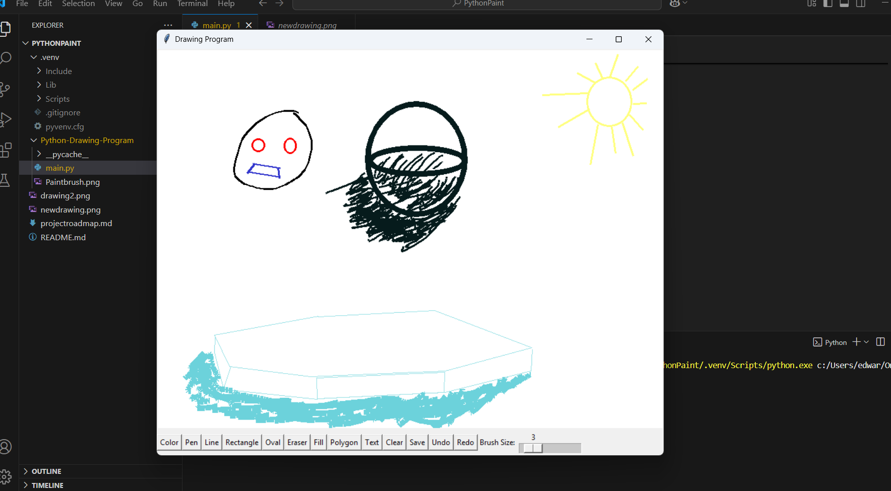
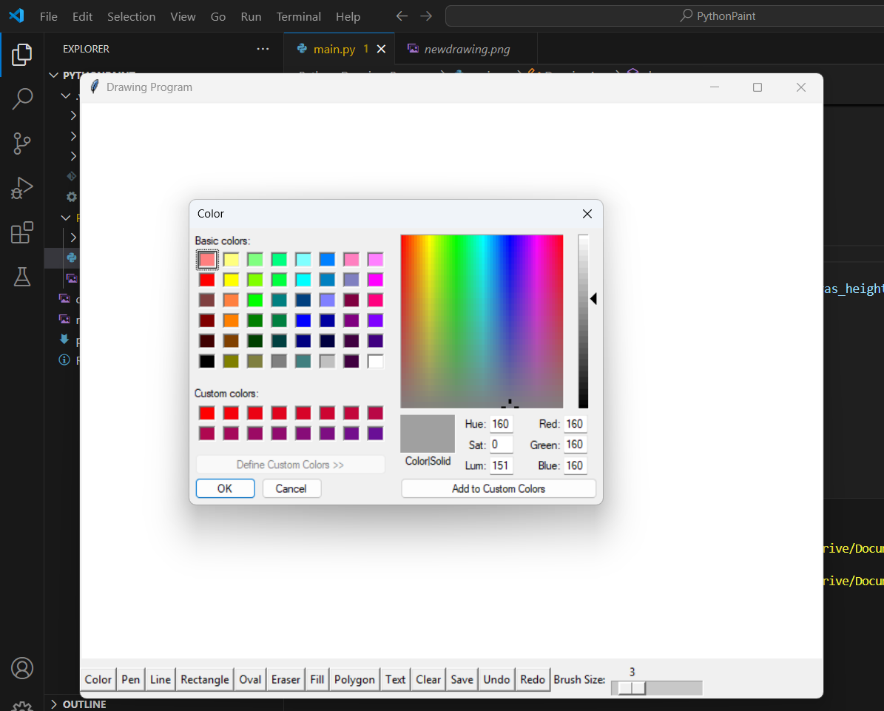
Python Paint
By: Edward Kagan
Python Paint is an attempt to make a clone
of Microsoft Paint in Python.
The purpose of making this was so that I could better understand what went into making applications like pain and photoshop
The feature that looks the coolest to me is the fact that we have a full color picker

